Slide 1

UNDERSTANDING MENTAL HEALTH RISK FACTORS AMONG ADULTS
PRESENTED BY;
TETE J. TEDI
SUPERVISED BY;
ANALYST FLORENCE OPARA
JULY,2026

Slide 2
OUTLINE
INTRODUCTION
DATA COLLECTION METHODOLOGY
DATA CLEANING AND PROCESSING
DATA VISUALIZATION
ANALYSIS OF FINDINGS
RECOMMENDATIONS
IDEAS FOR FUTURE WORK
CONCLUSION
SOURCES

Slide 3
INTRODUCTION
Mental health is a state of well-being that allows people to cope with stress, learn and work well, and help their community.
It includes emotional, psychological, and social well-being.

Slide 4
Problem statement
Over one billion people globally—or roughly one in seven individuals—are struggling with mental health conditions, with anxiety and depression being the most common.
Approximately one in four Nigerians (over 40 to 50 million people) suffers from a mental health condition.
Mental health professionals, workplaces, and educational institutions need better tools to identify individuals at higher risk of anxiety, depression, or stress-related issues.
Translate these insights into practical prevention and support strategies.

Slide 5
DATA COLLECTION METHODOLOGY
The dataset contains 25,000 records with structured features divided into five major categories:
Demographic Information
Includes age, gender, marital status, education level, and employment status.
Lifestyle Factors
Includes sleep duration, physical activity, screen time, and social support score.
Work & Academic Stress Indicators
Includes work stress level, academic pressure, job satisfaction, financial stress, and weekly working hours.

Slide 6
DATA COLLECTION METHODOLOGY
Psychological Indicators
Includes anxiety score, depression score, overall stress level, mood swings frequency, concentration difficulty, and panic attack history.
Medical & Family History
Includes family history of mental illness, previous diagnosis, therapy history, and substance use.

Slide 7
DATA COLLECTION METHODOLOGY
Work & Academic Stress Indicators
Includes work stress level, academic pressure, job satisfaction, financial stress, and weekly working hours.
Psychological Indicators
Includes anxiety score, depression score, overall stress level, mood swings frequency, concentration difficulty, and panic attack history.
Medical & Family History
Includes family history of mental illness, previous diagnosis, therapy history, and substance use.

Slide 8
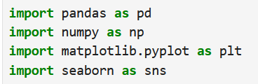
DATA CLEANING AND PROCESSING
IMPORTING OF LIBRARIES

Slide 9
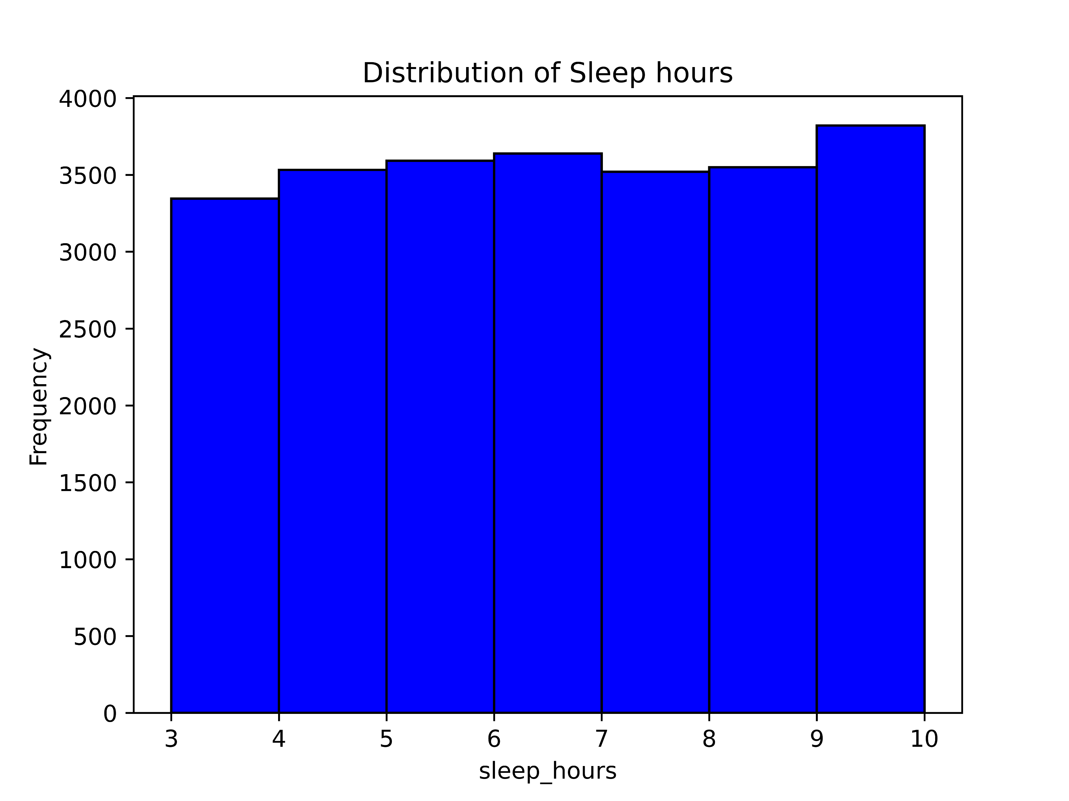
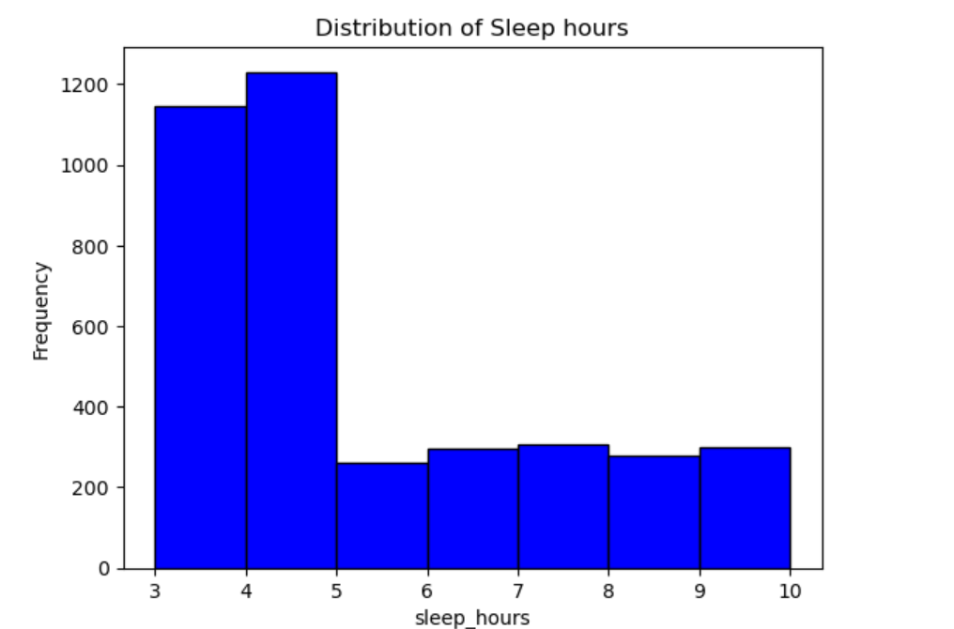
DATA VISUALIZATION

Slide 10
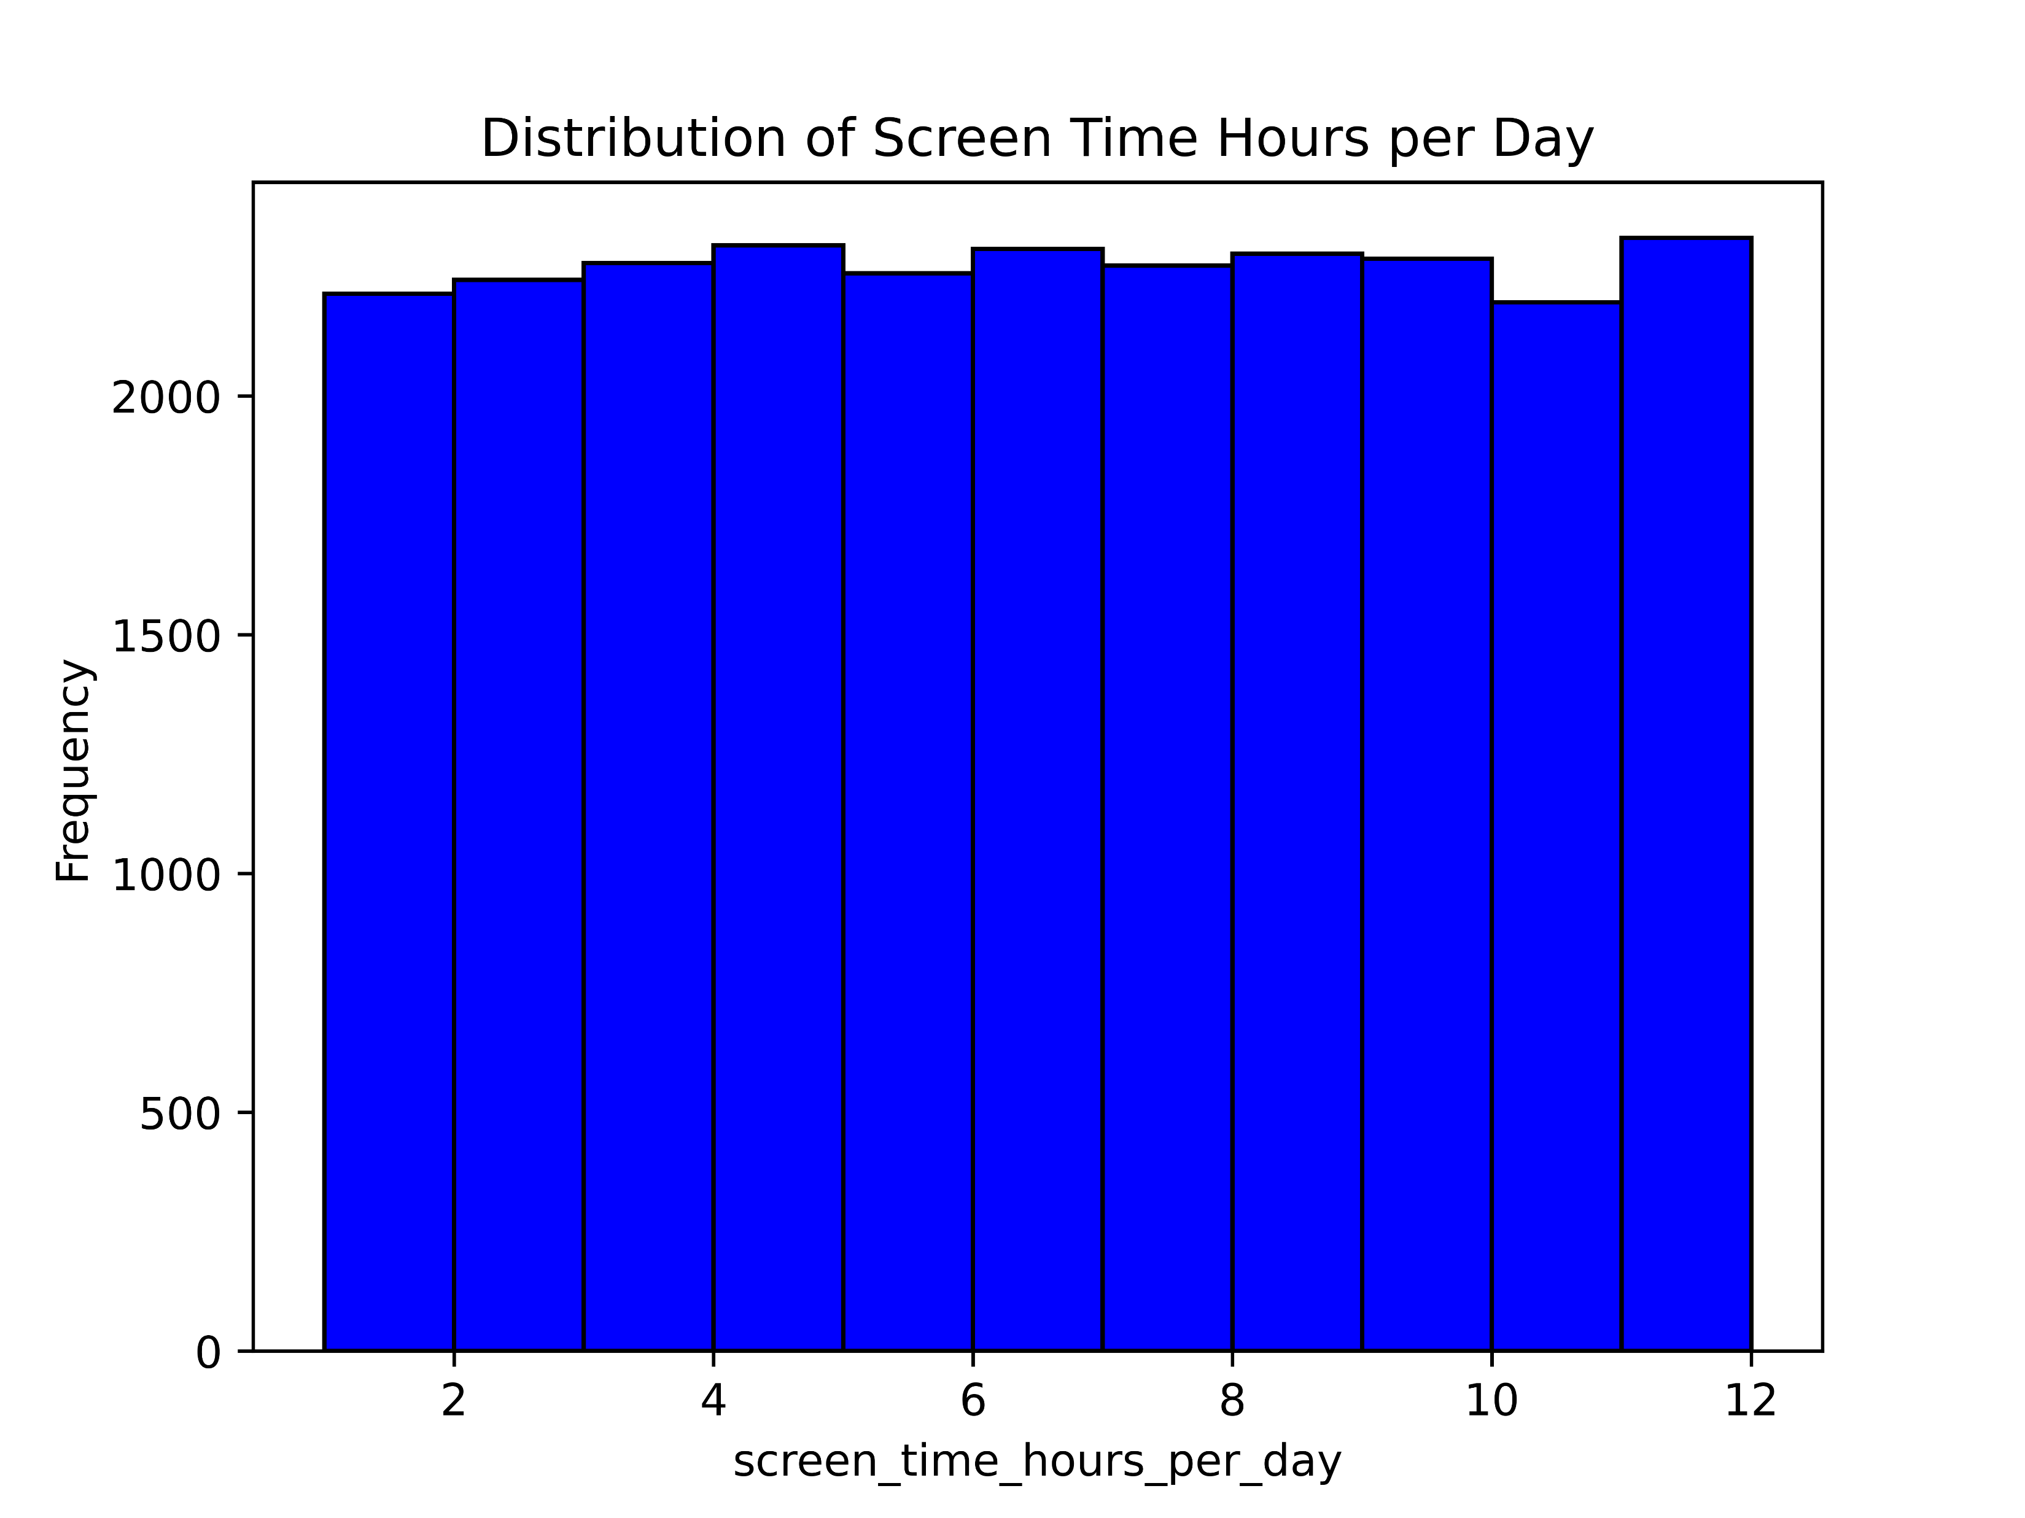
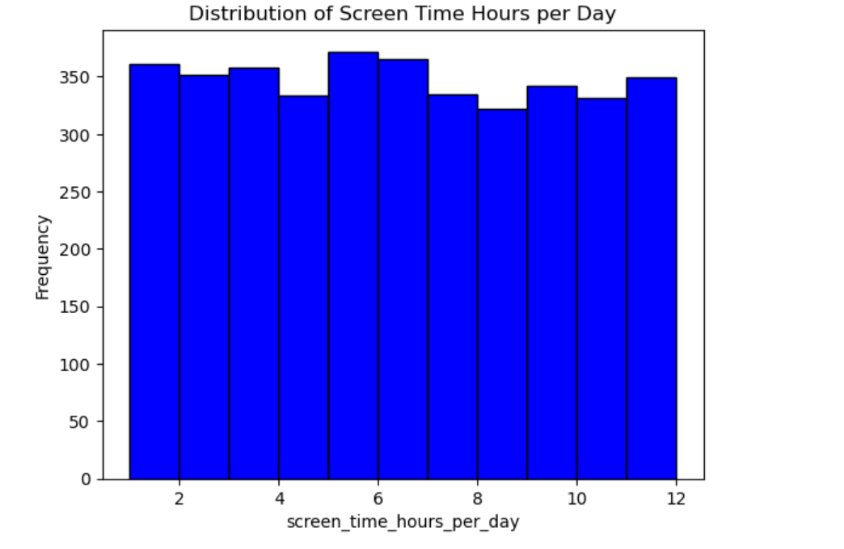
DATA VISUALIZATION

Slide 11
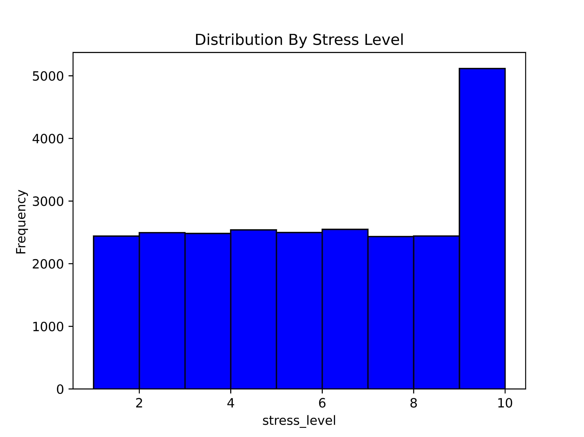
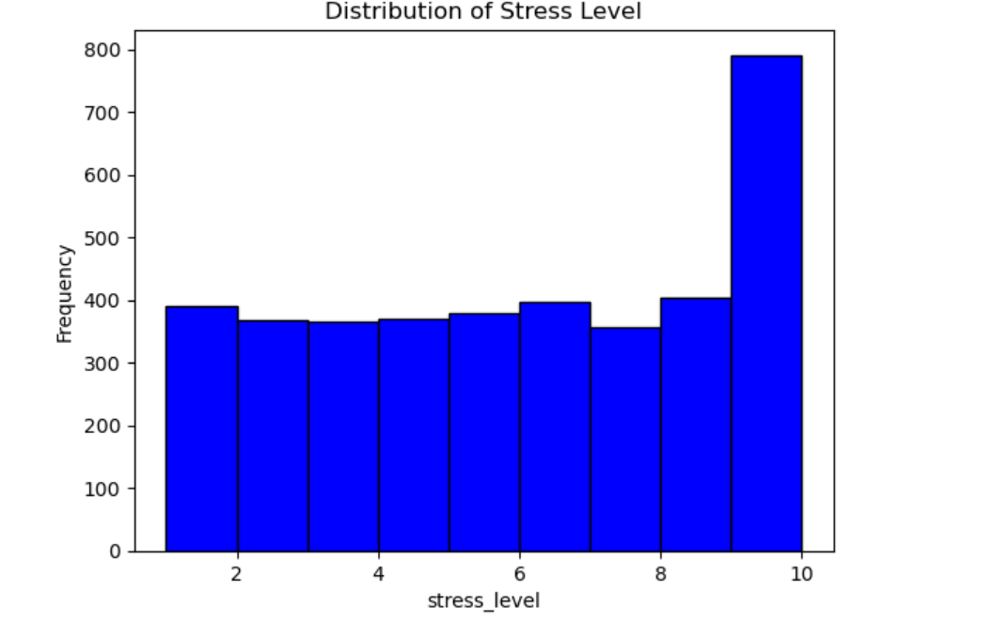
DATA VISUALIZATION

Slide 12
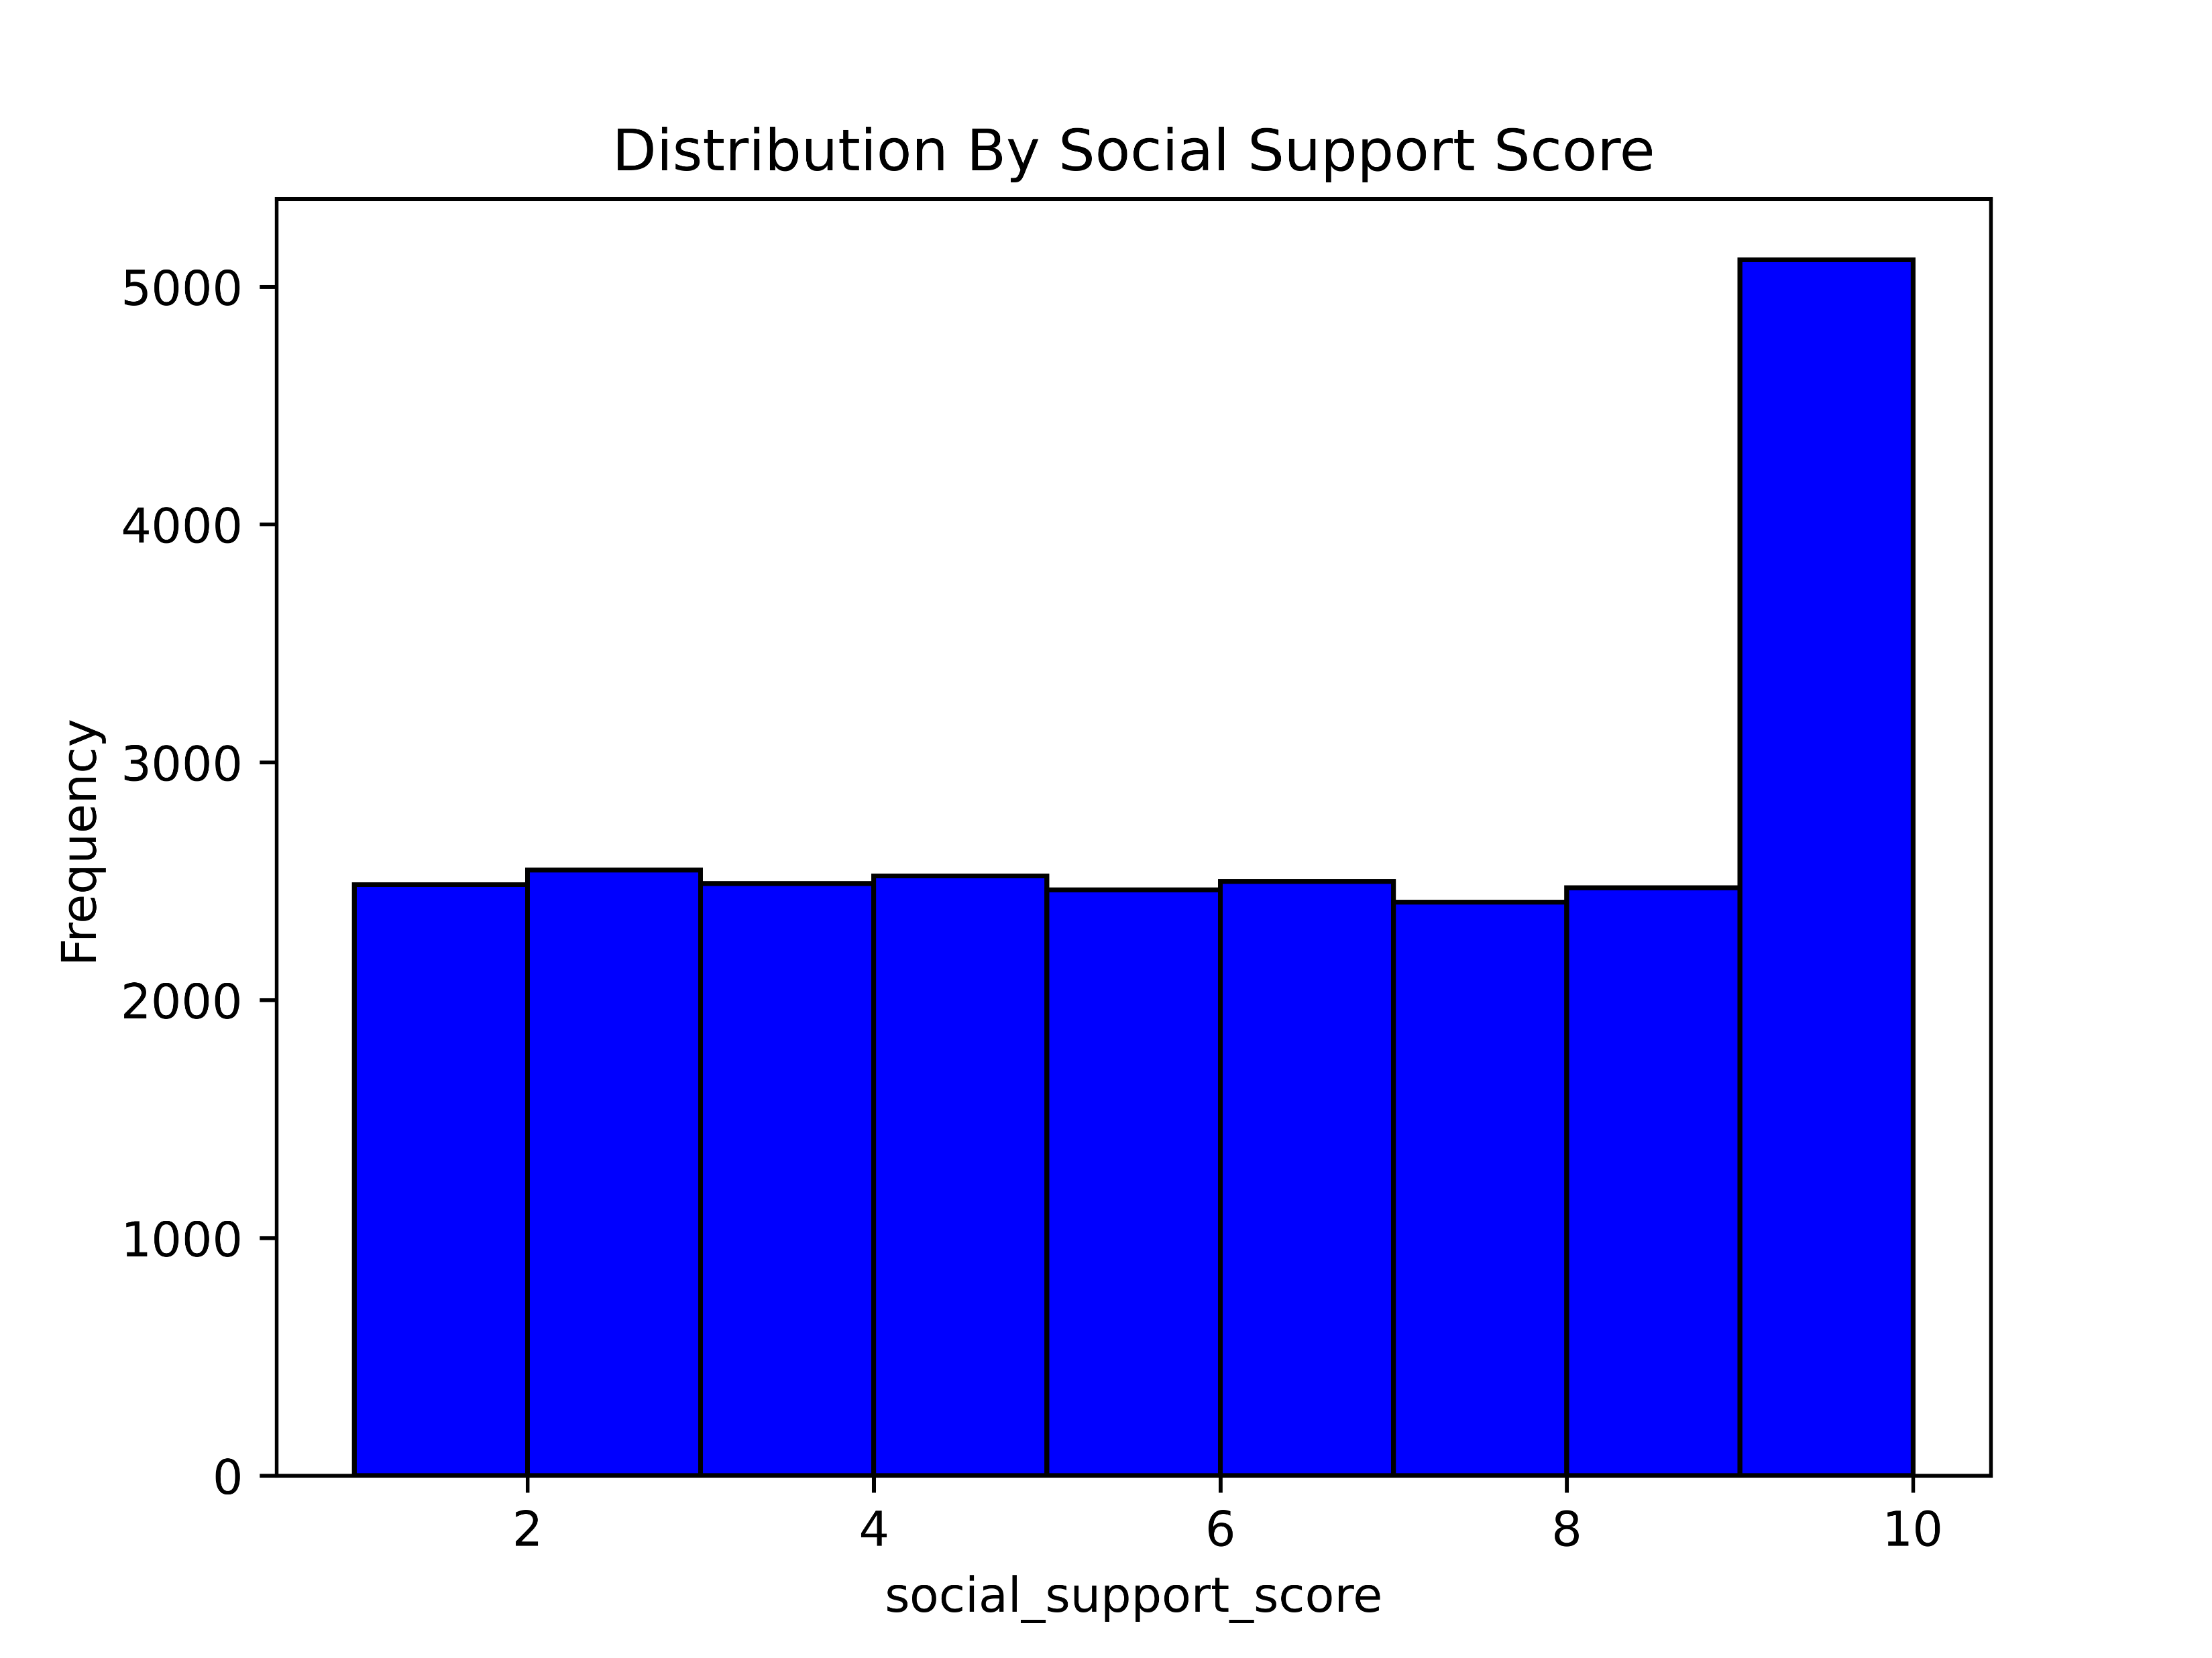
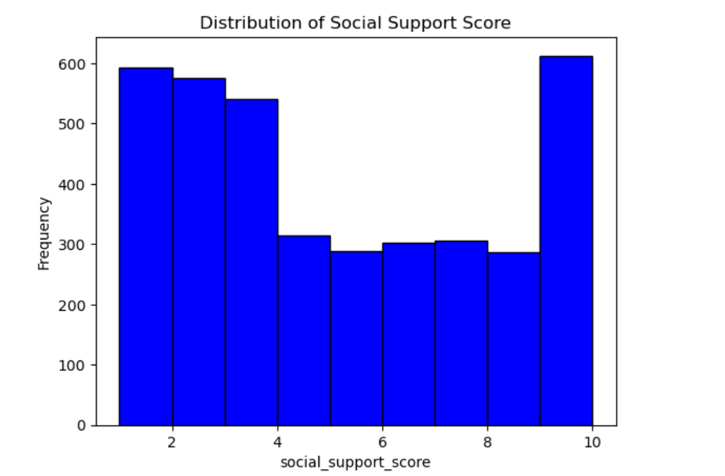
DATA VISUALIZATION

Slide 13
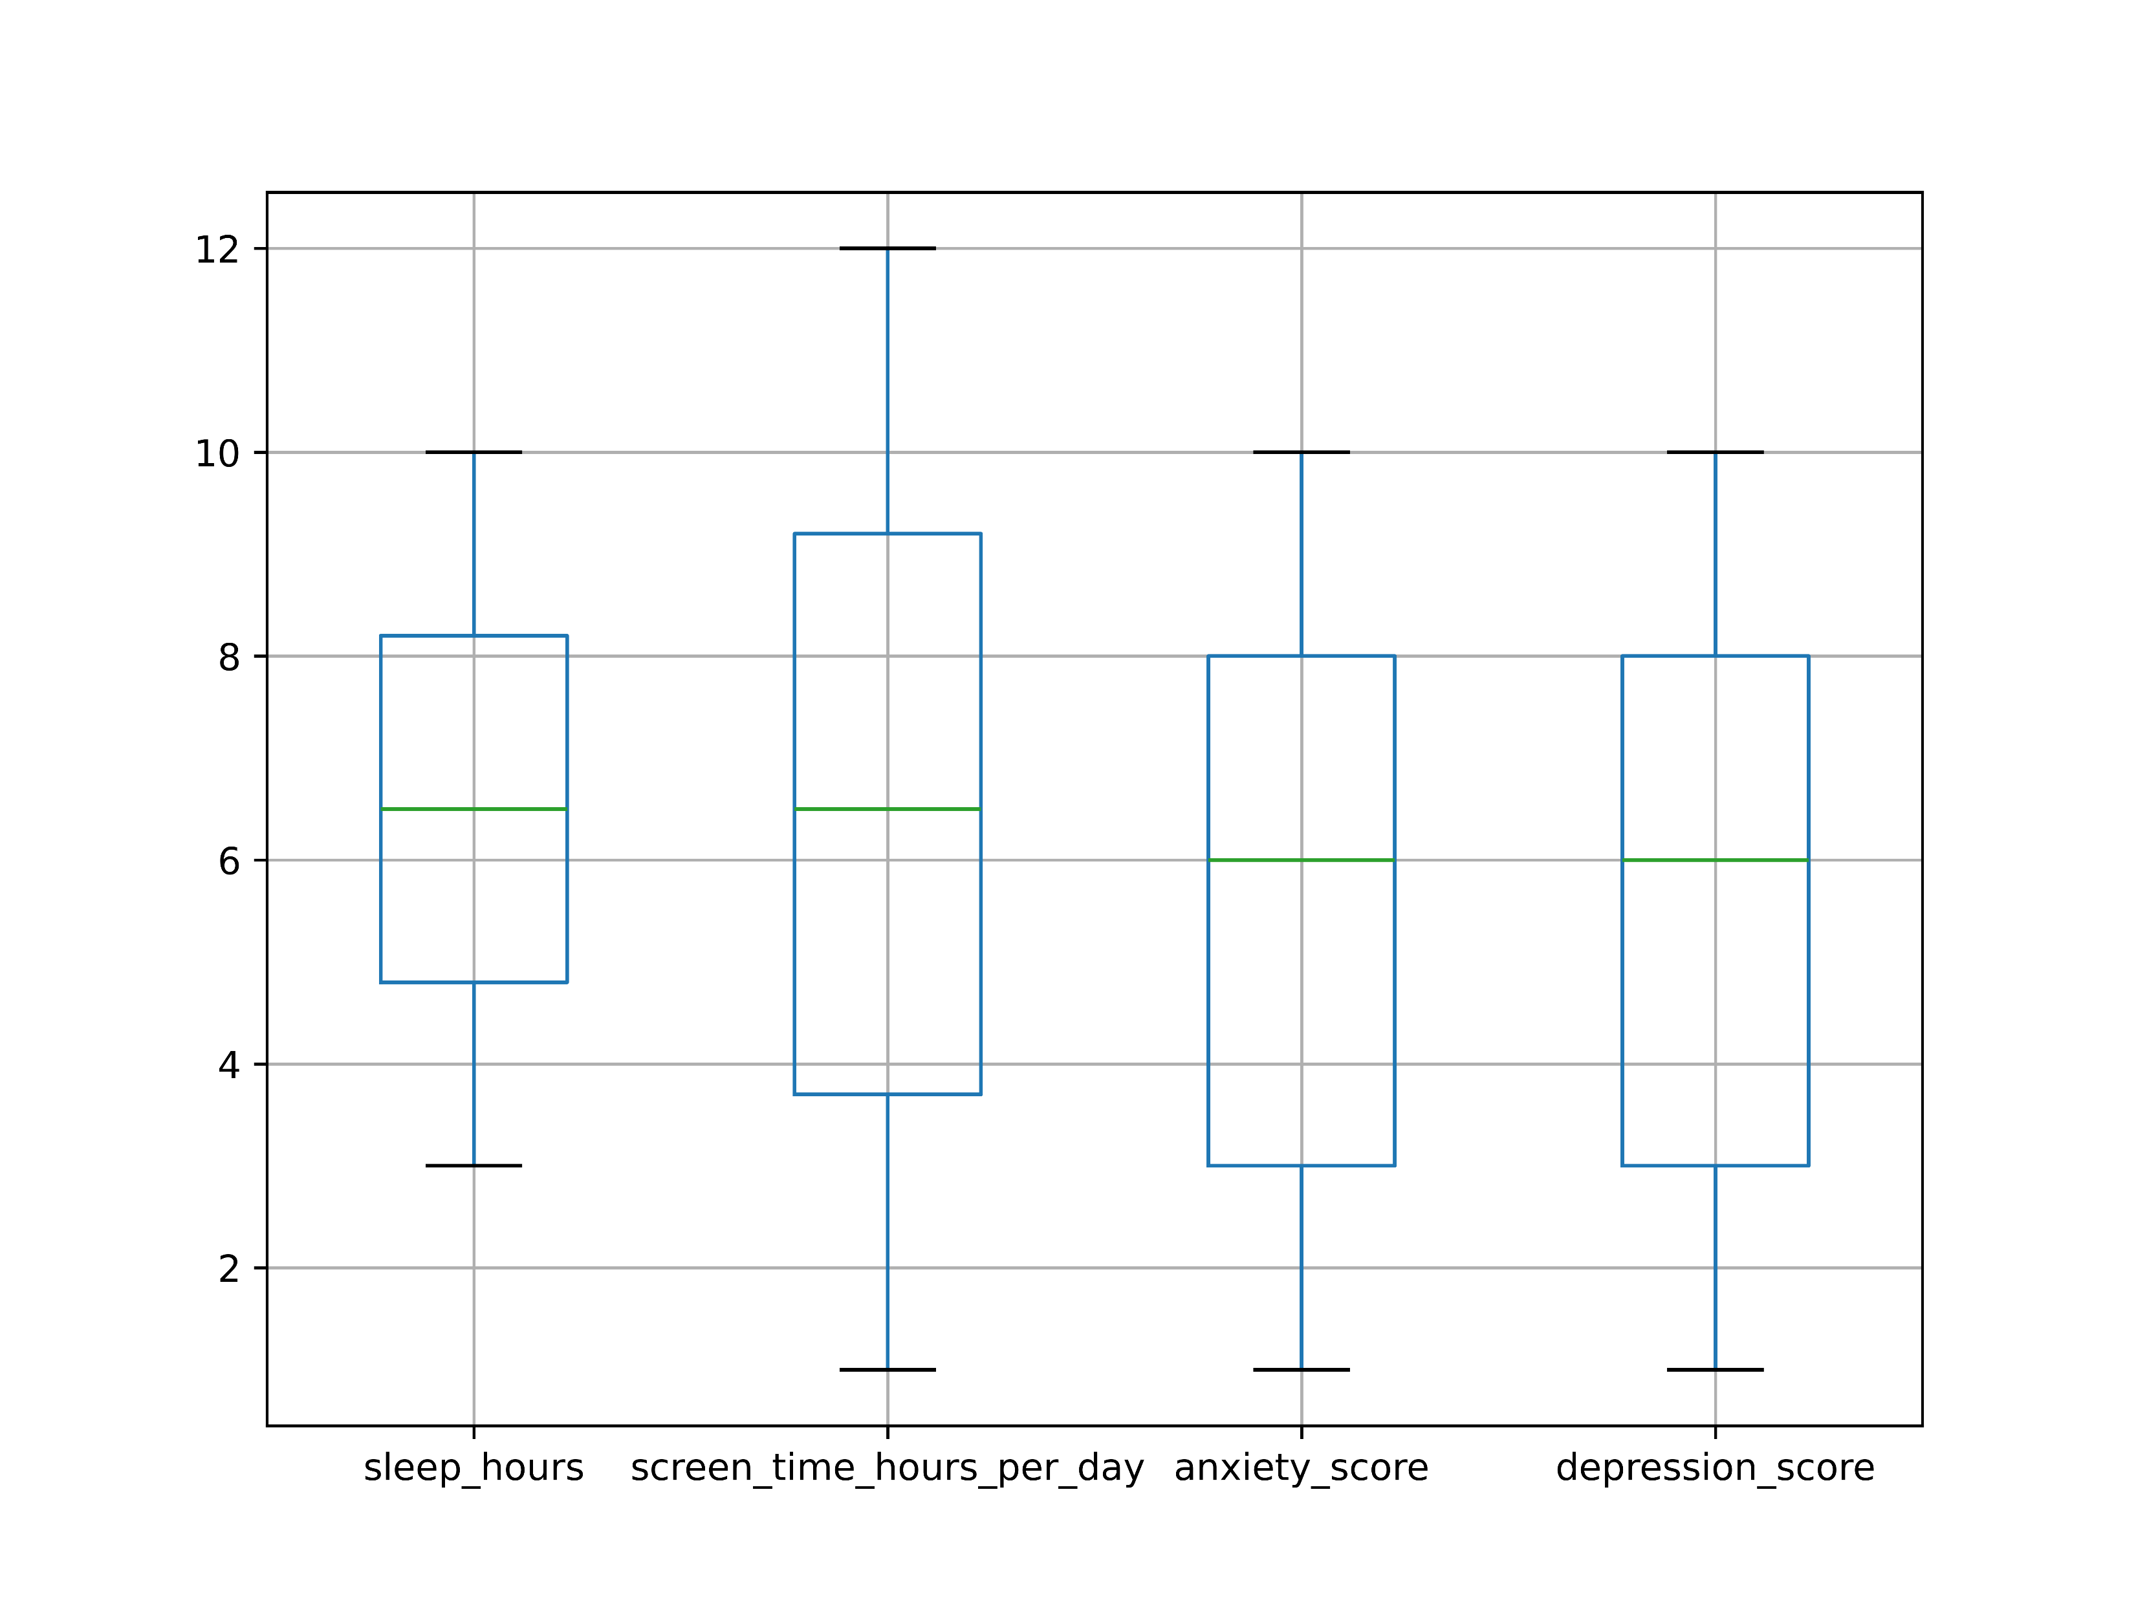
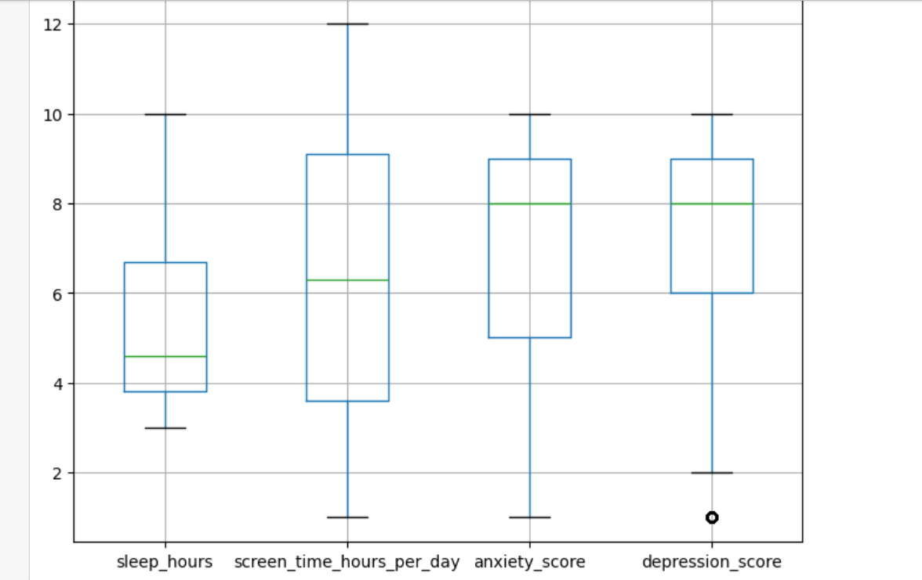
DATA VISUALIZATION

Slide 14
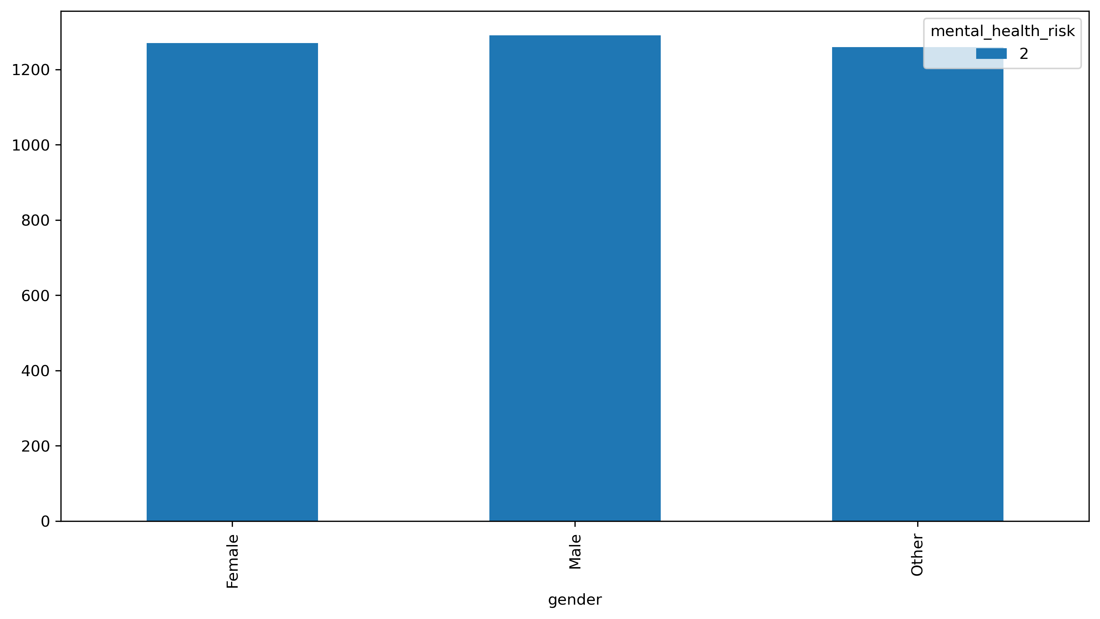
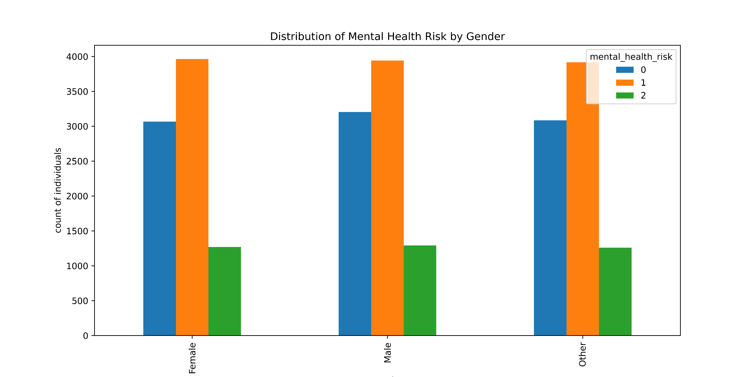
DATA VISUALIZATION

Slide 15
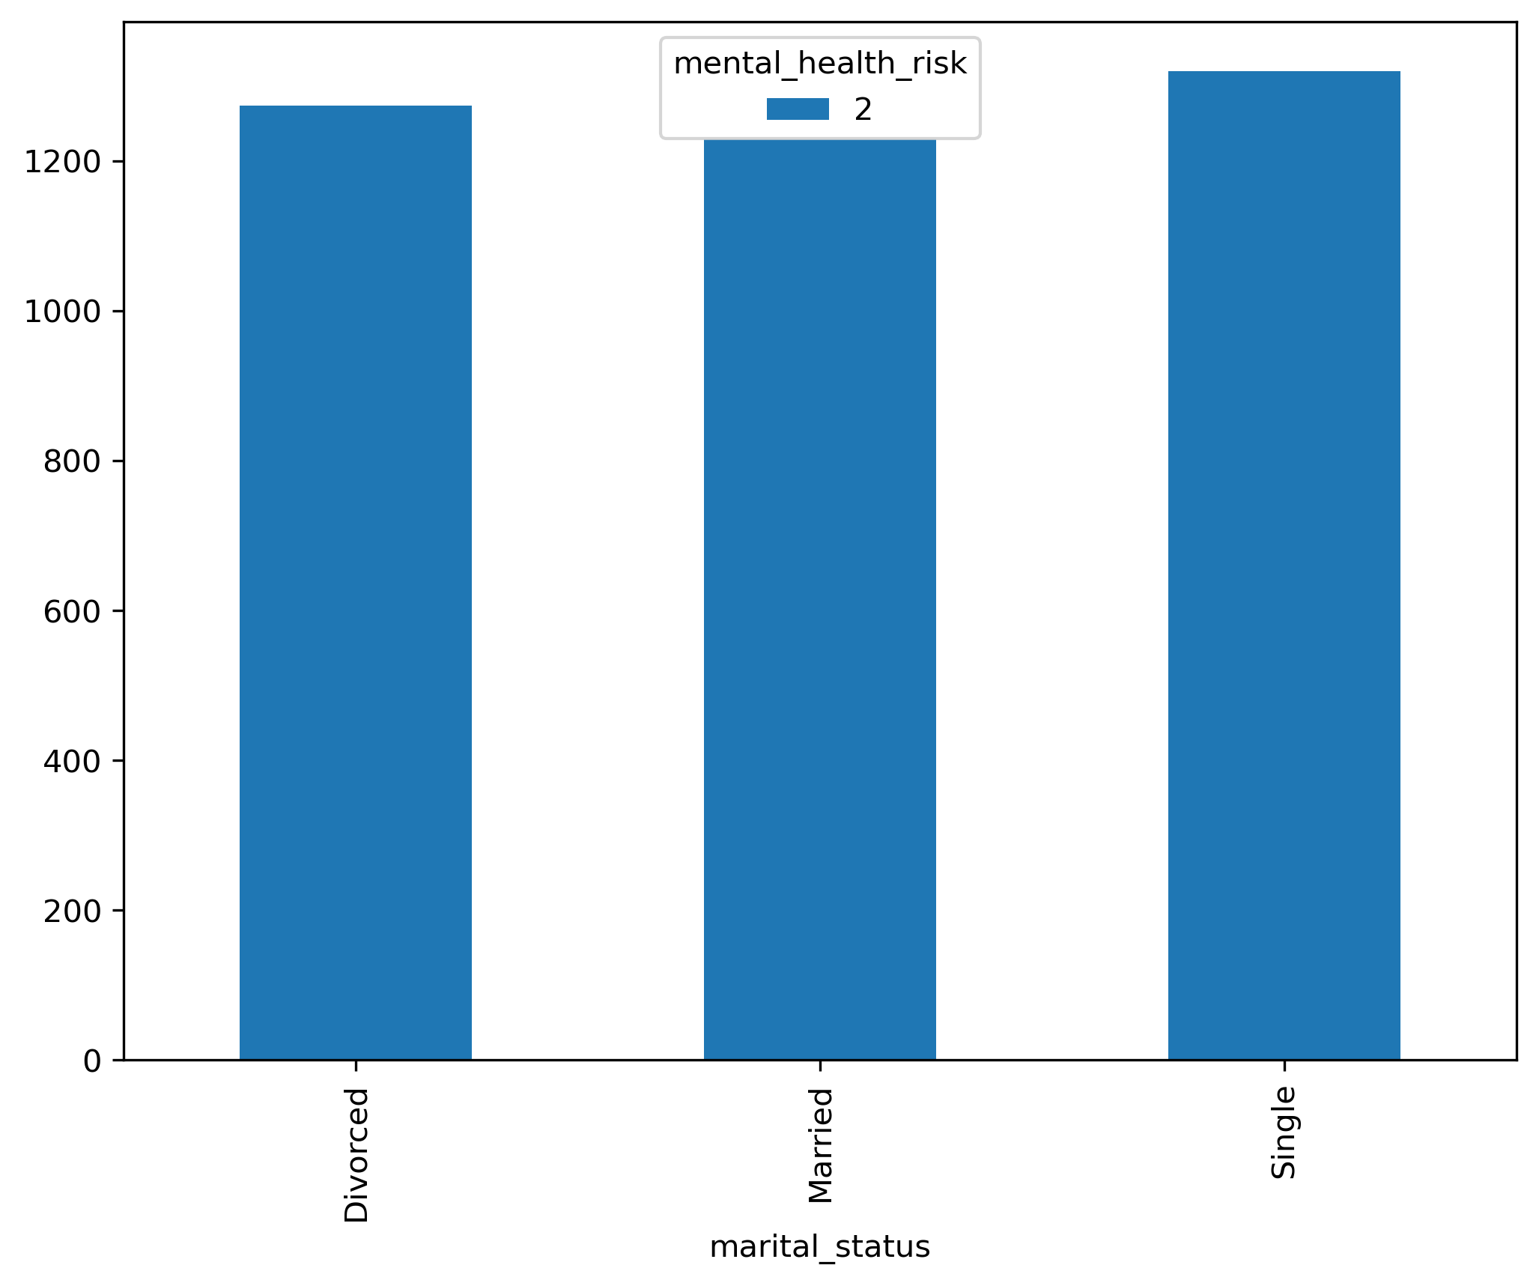
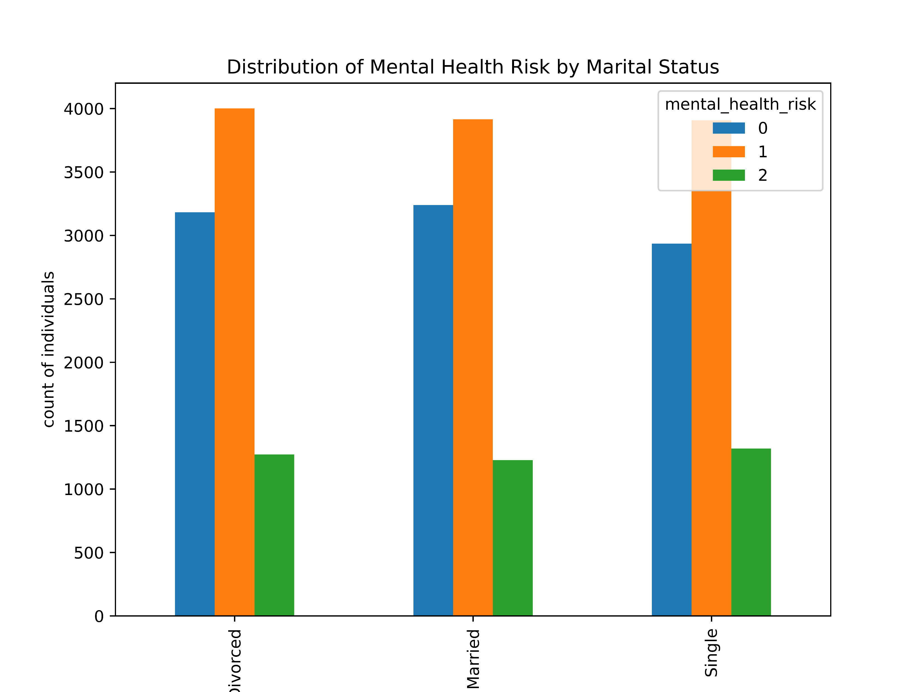
DATA VISUALIZATION

Slide 16
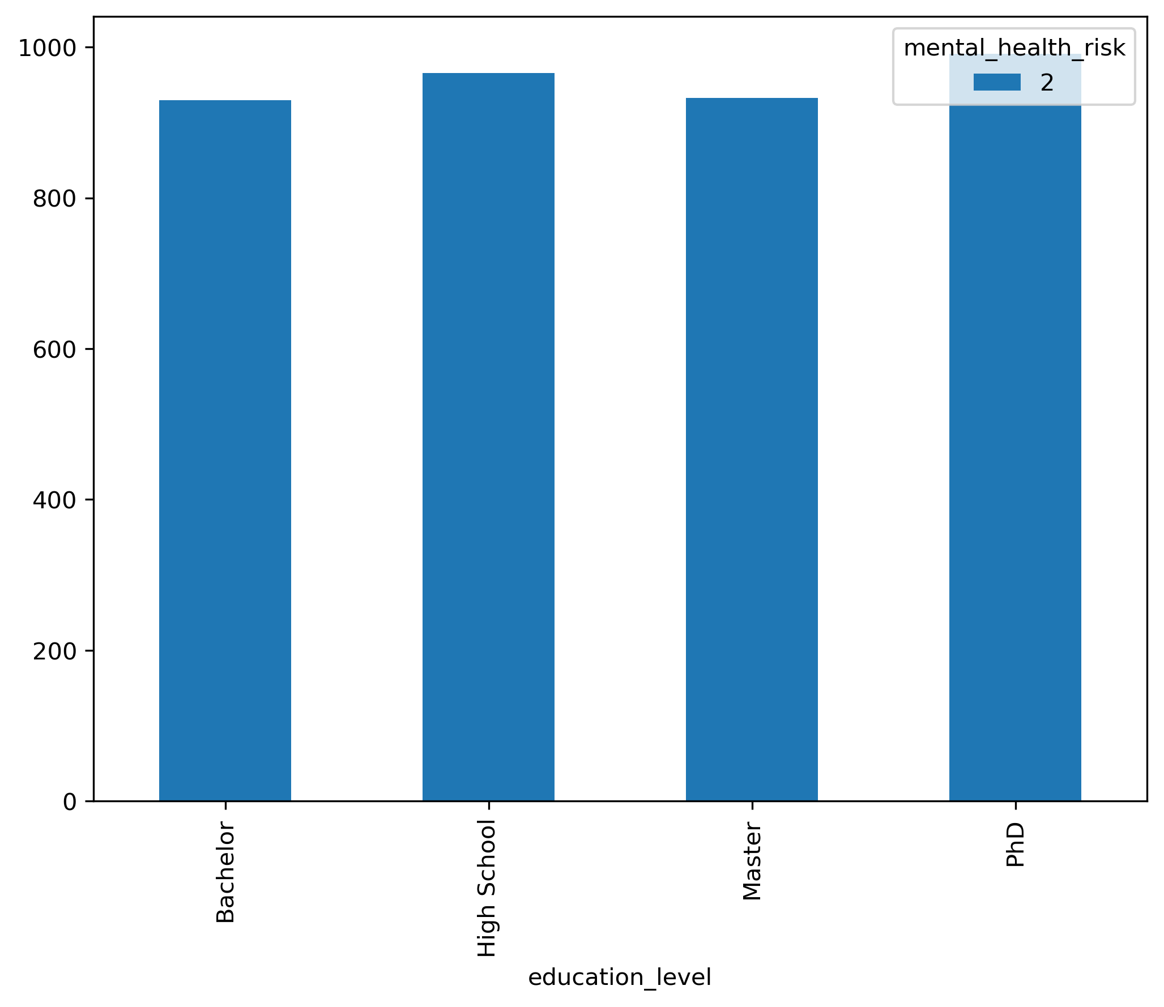
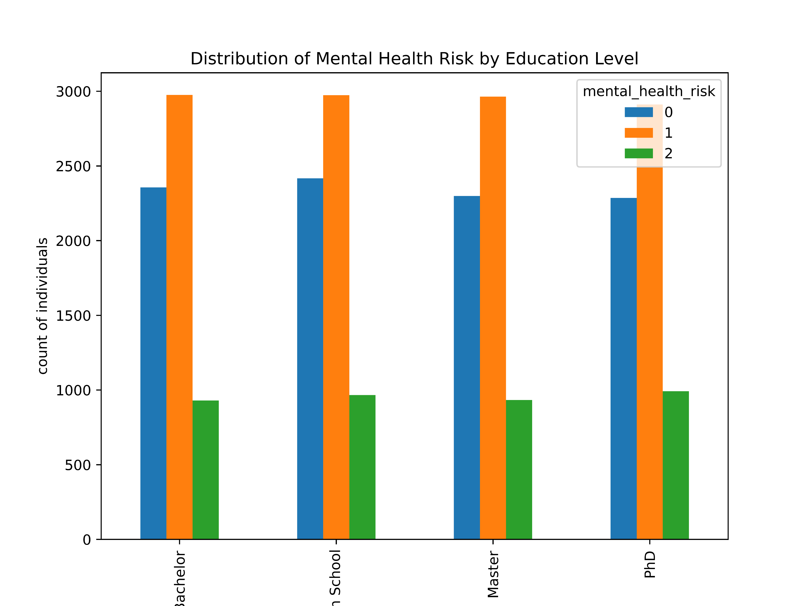
DATA VISUALIZATION

Slide 17
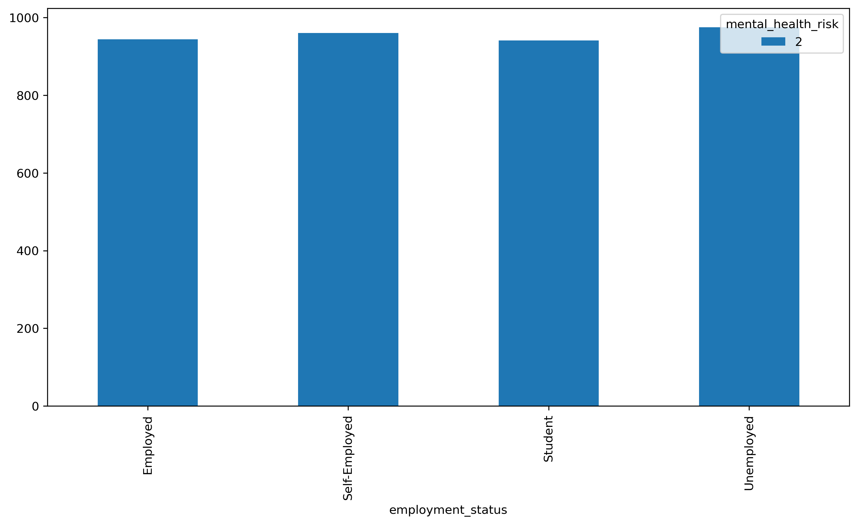
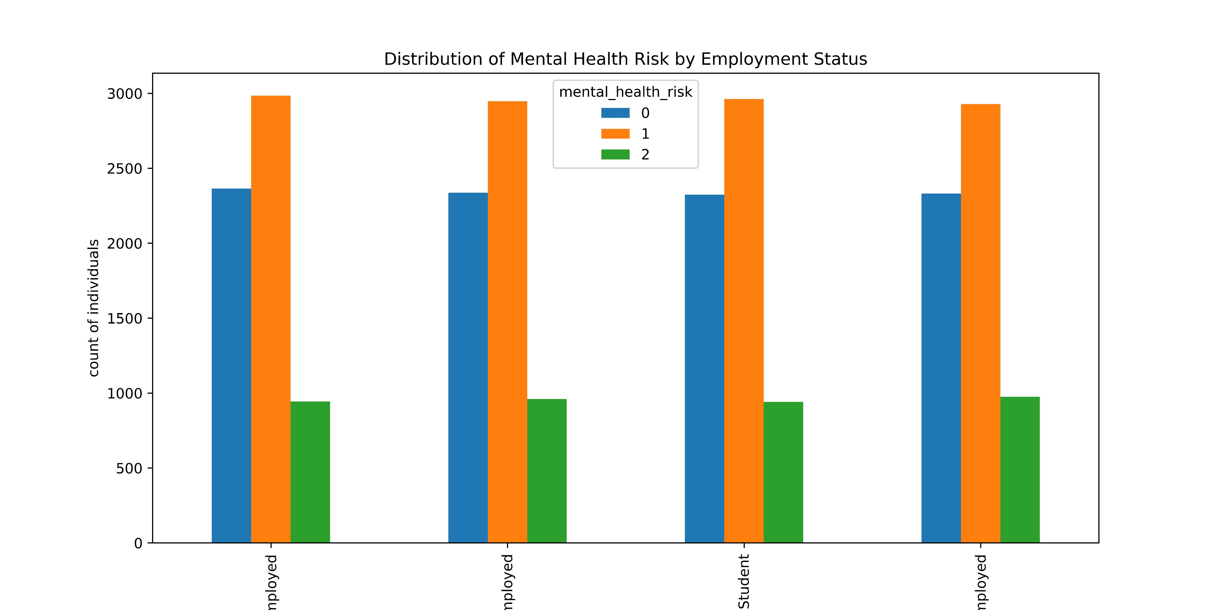
DATA VISUALIZATION

Slide 18
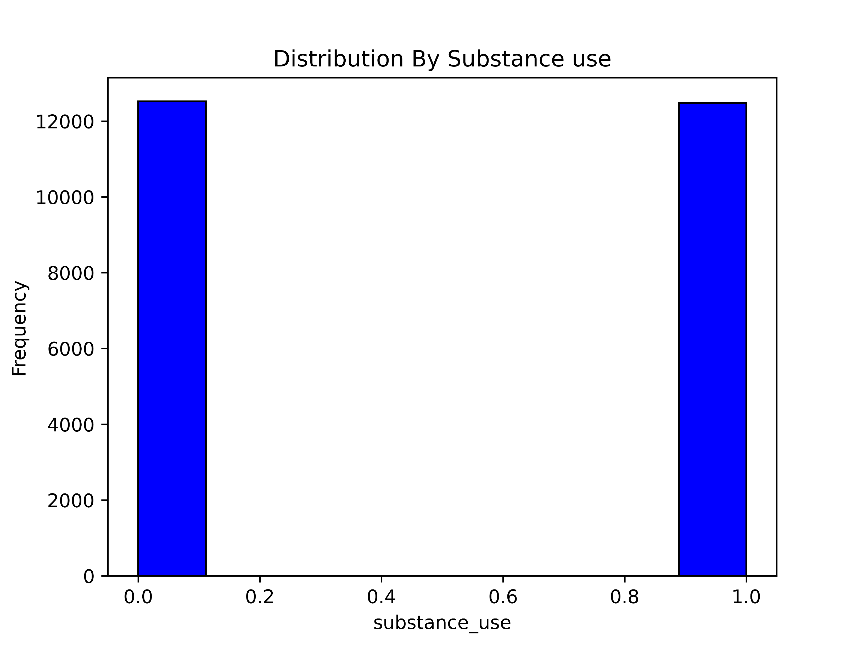
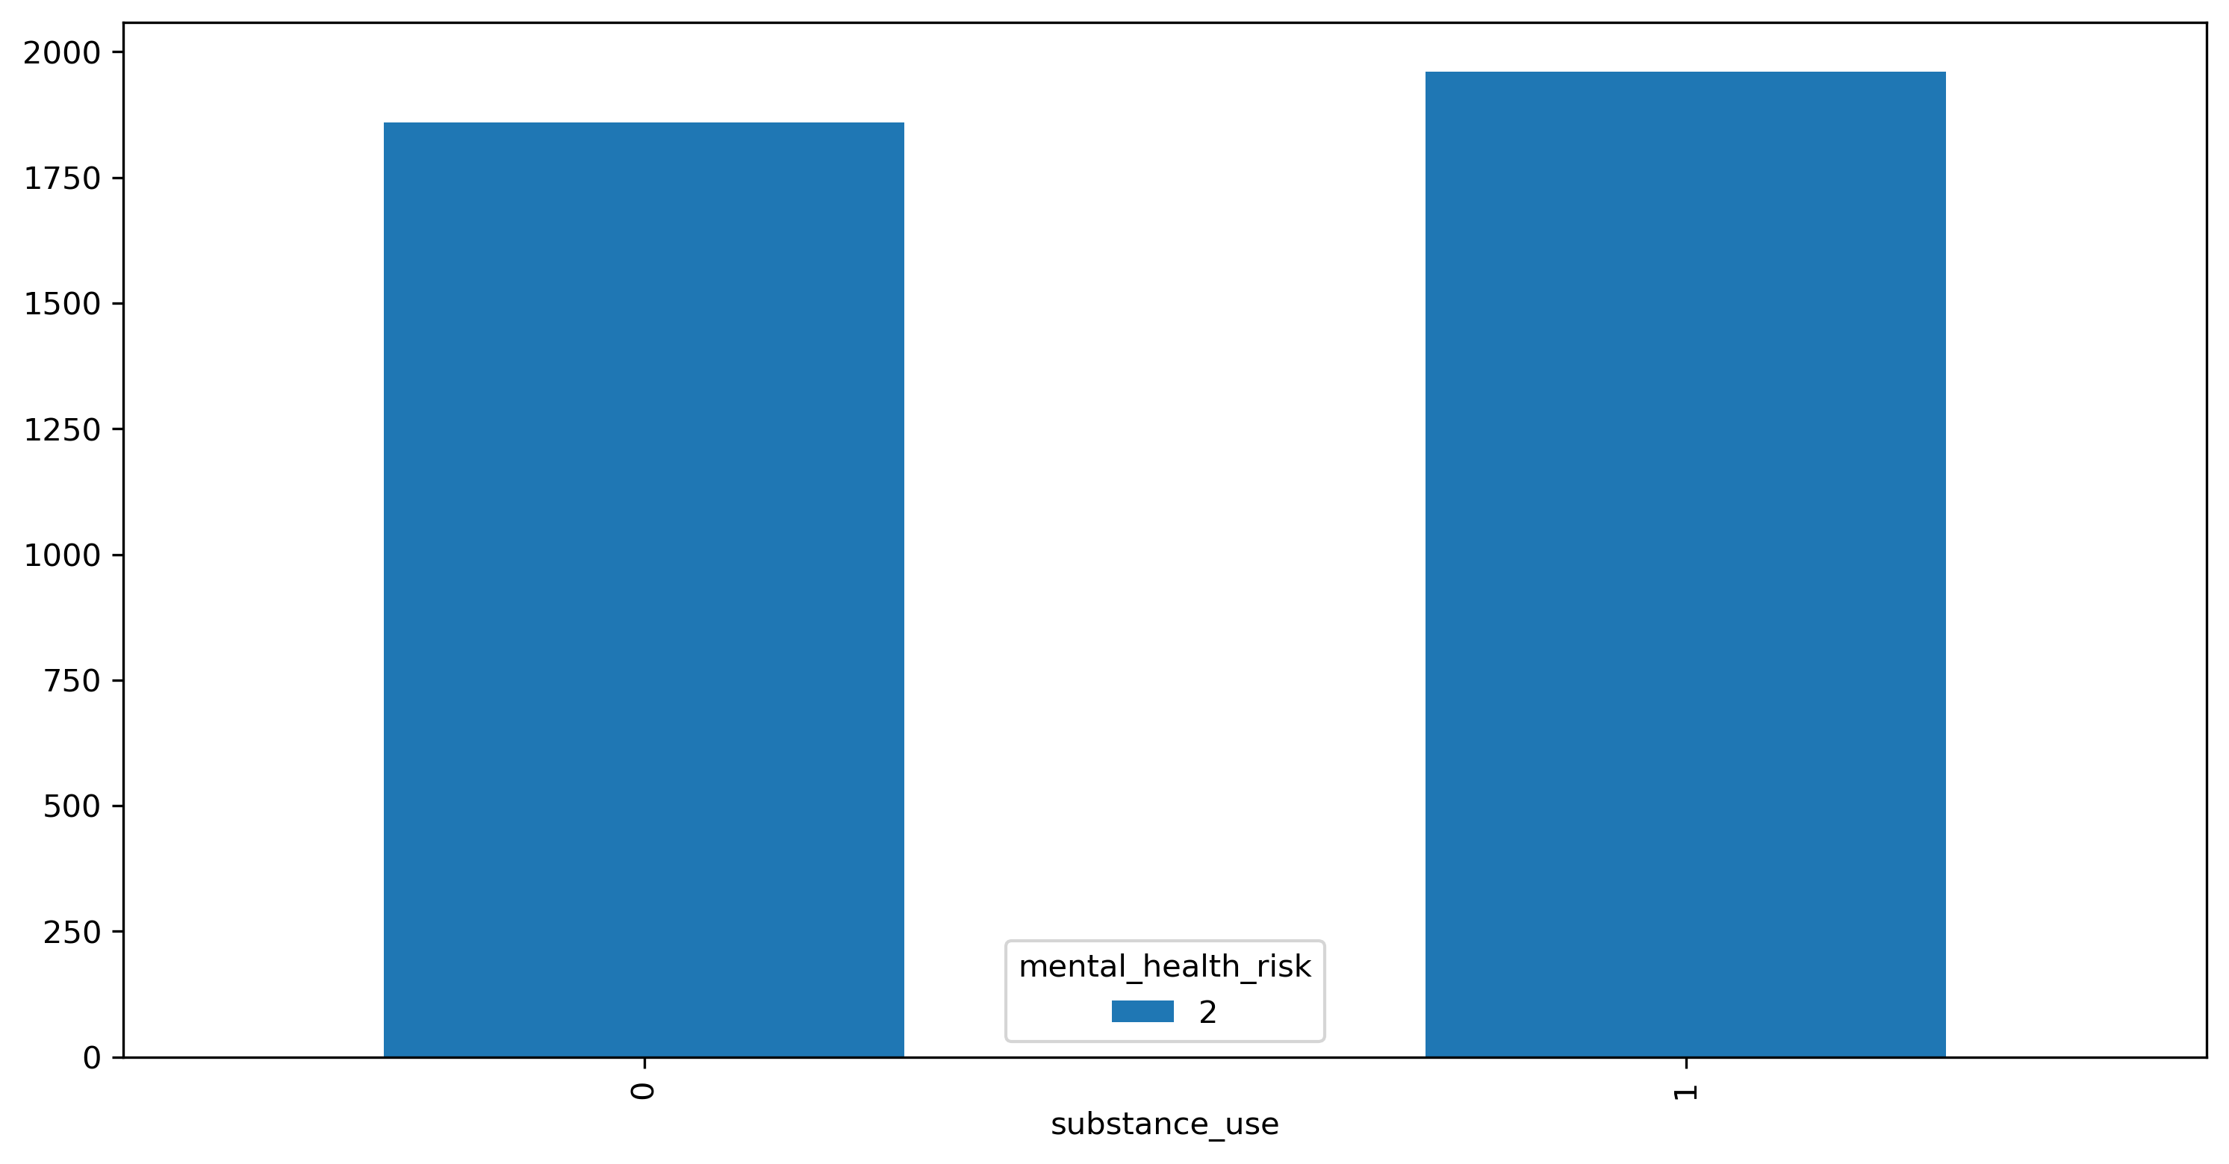
DATA VISUALIZATION

Slide 19
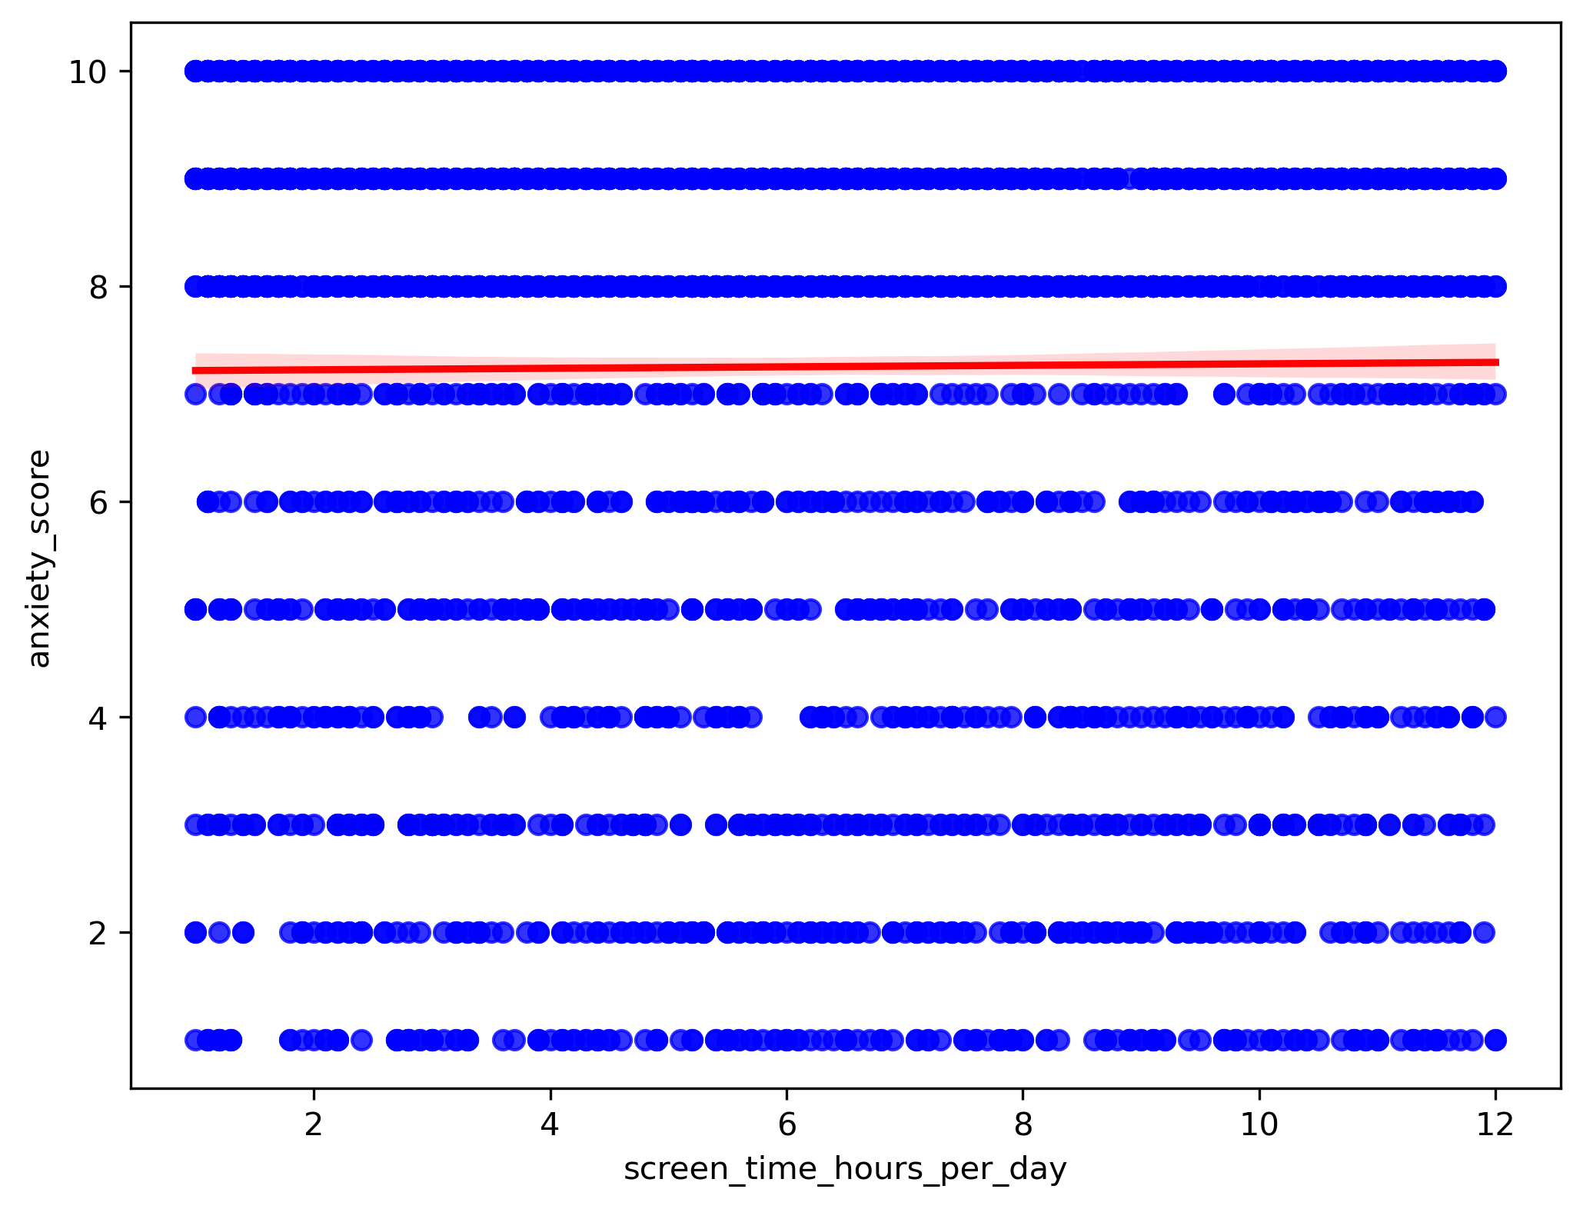
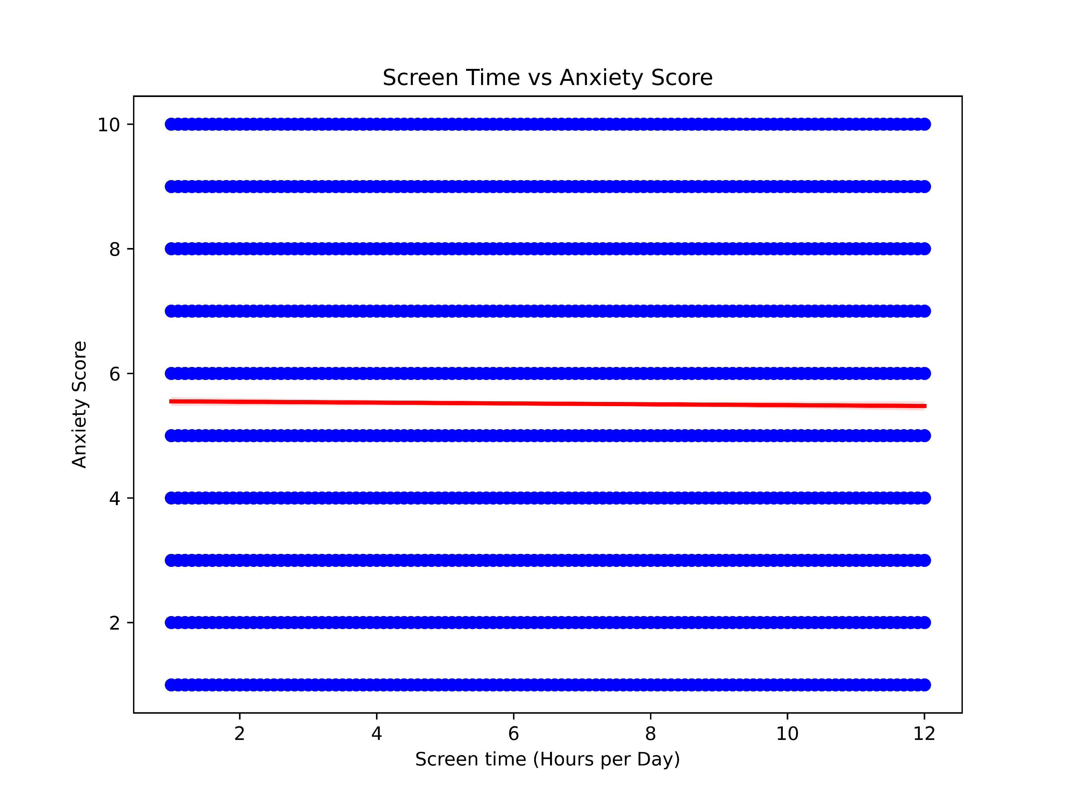
DATA VISUALIZATION

Slide 20
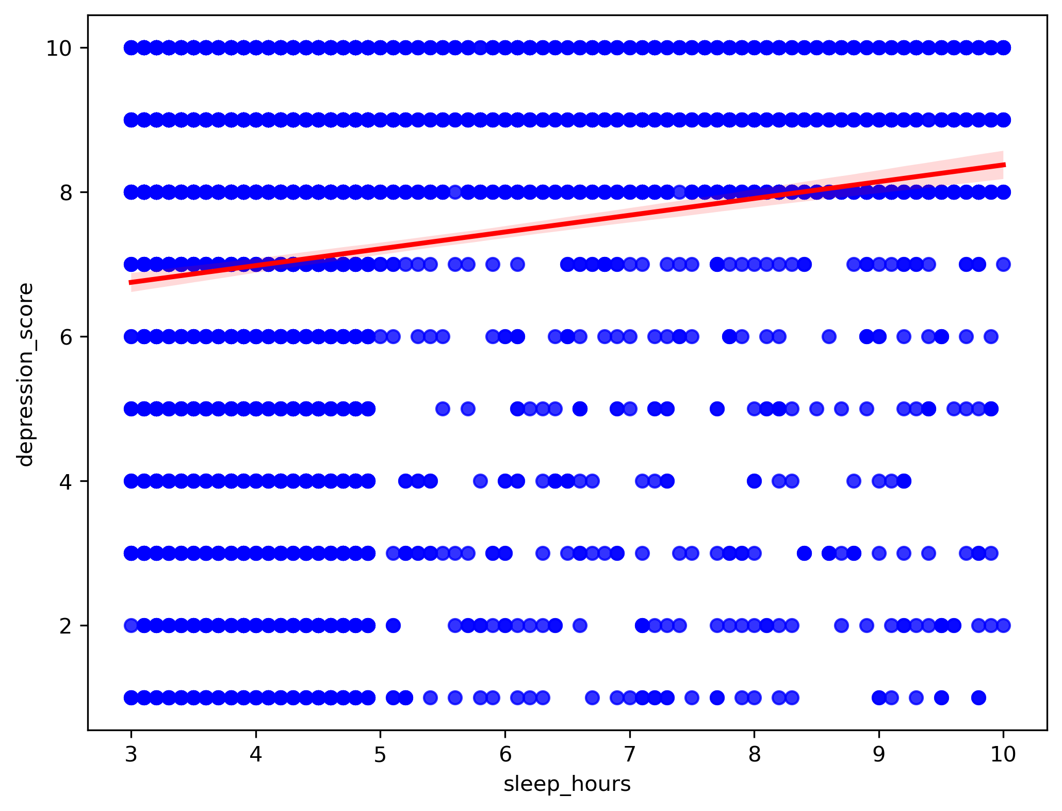
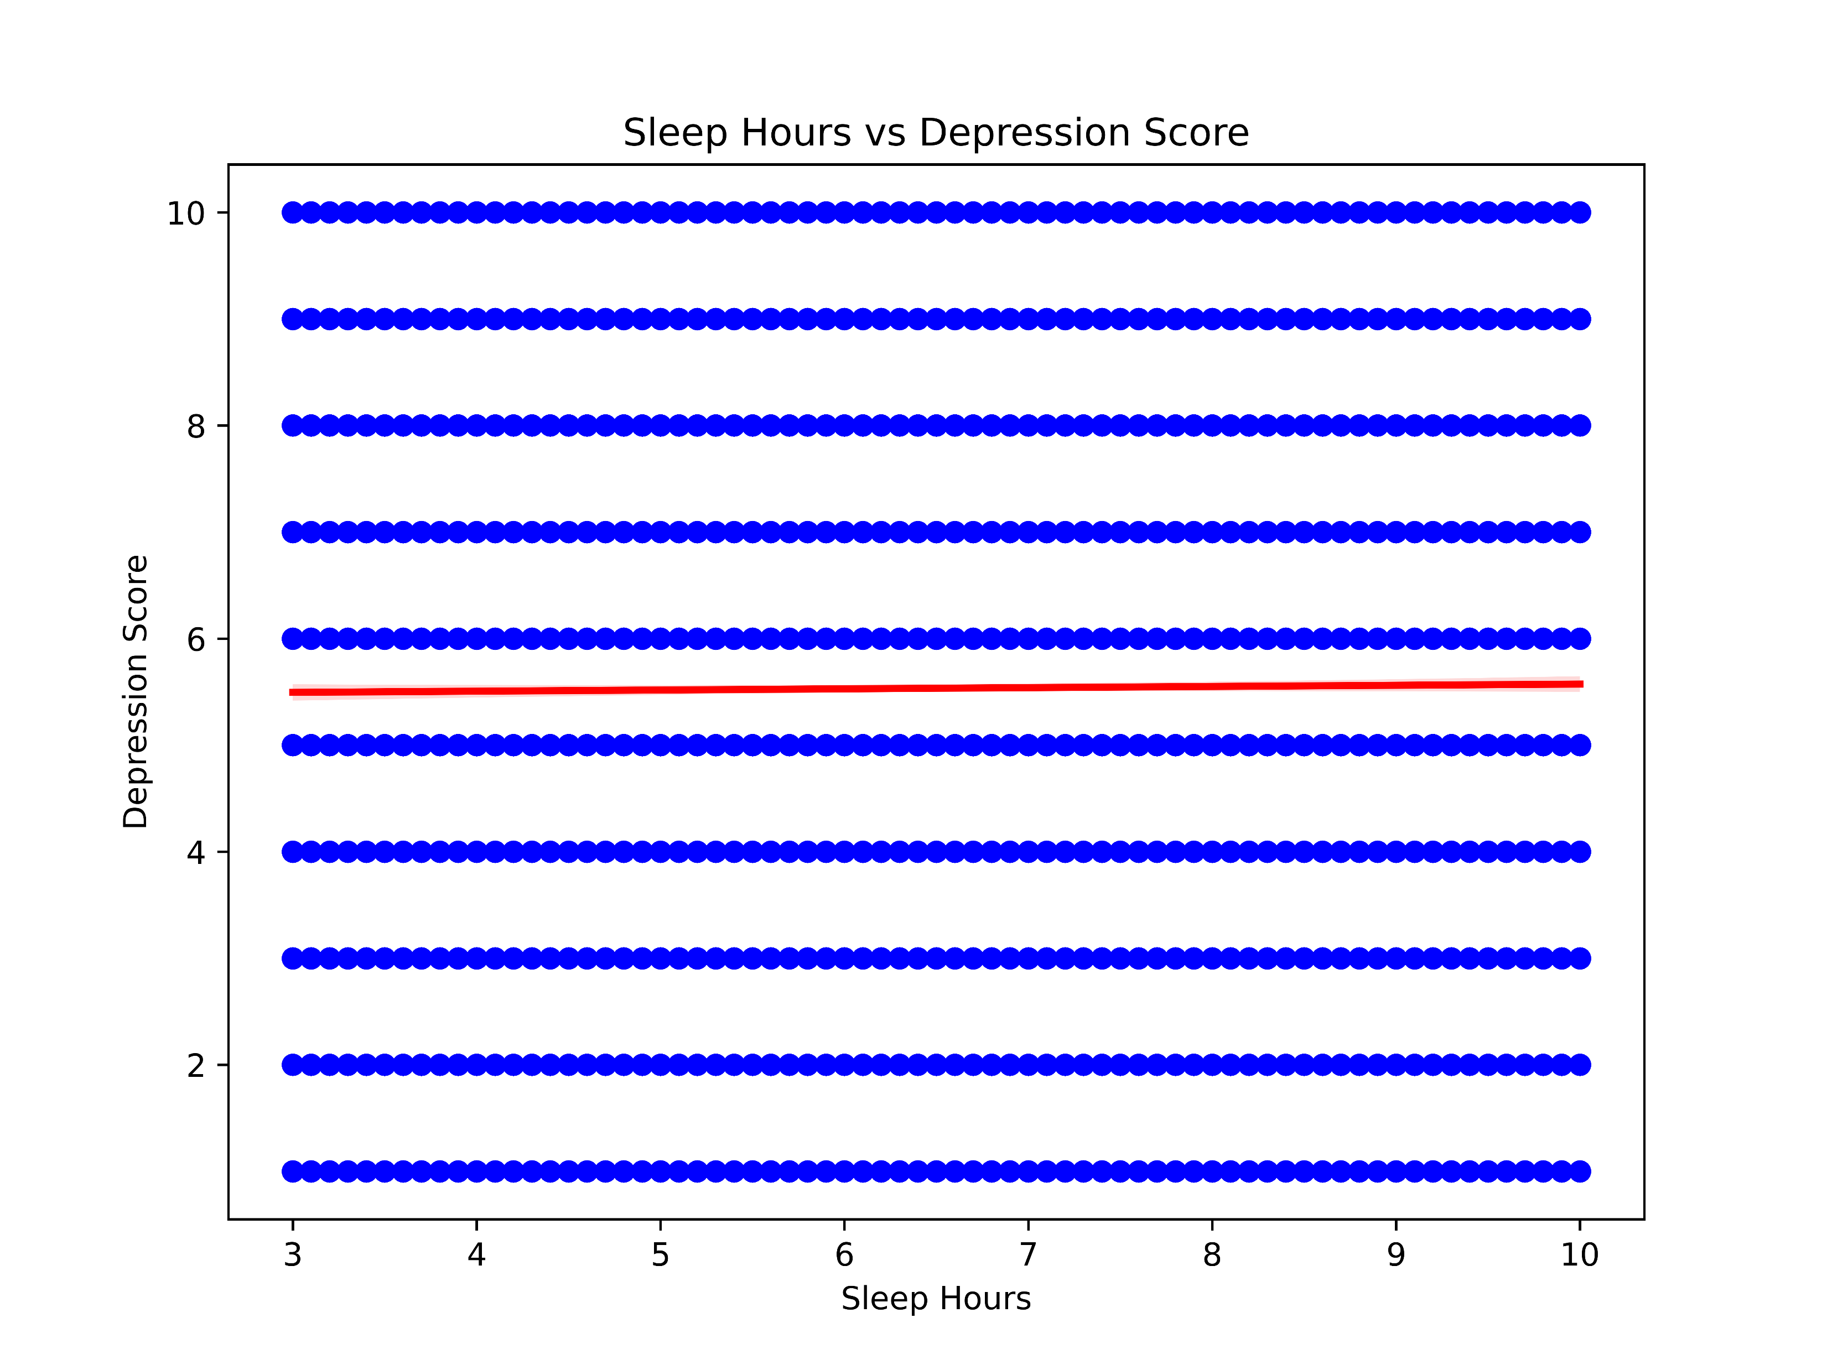
DATA VISUALIZATION

Slide 21
RECOMMENDATION
INDIVIDUALS
Get rest, engage in exercise, stay connected to people that care about you.
EMPLOYERS AND INSTITUTIONS
Manage workloads, train leaders, offer flexibility.
POLICY MAKERS AND EDUCATORS
Expand work force, organize mental health awareness campaigns across society.

Slide 22
IDEAS FOR FUTURE WORK
Longitudinal studies
Predictive modeling
Intervention evaluation

Slide 23
CONCLUSION
Mental health risk factors and also Identity of individual at high risk of mental health condition were successfully identified based on the dataset provided.
Real time data on mental health is crucial as it transforms how clinical psychology, psychiatry, and public health systems identify risks, deliver treatments, and evaluate policy outcomes.

Slide 24
RESOURCES
CLASS NOTE
GEEKSFORGEEKS
WHO
YouTube
Kaggle

Slide 25


